Slide 1
LLMs
Transformers
Prompting
RAG
Quantization
Fine Tuning

Slide 2
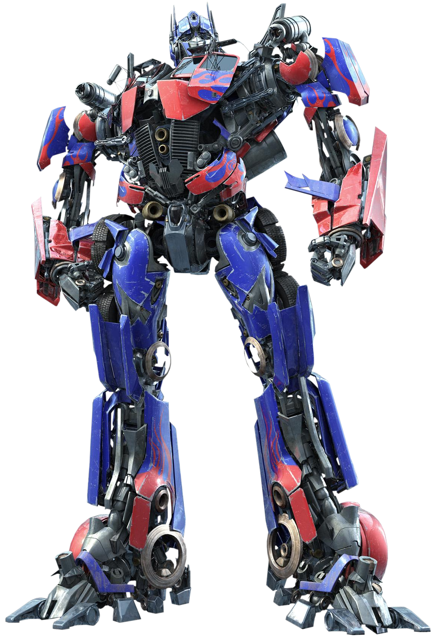
Transformers
Slides based on “The Illustrated Transformer” by Jay Allamar

Slide 3
Outline
Encoder-Decoder
Attention
Self Attention
Multi-head Attention
Transformer Architectures

Slide 4
Machine Translation – French to English
Input
Transformer
Output
Je suis etudiant
I am a student

Slide 5

The Transformer Architecture
We will take the figure from the 2017 paper and build it step-by-step
student
Current output: student
The encoder stack
Decoder
The decoder stack
Encoder
Decoder
Encoder
Decoder
Encoder
Decoder
Encoder
Embedding layer
Embedding layer
Input: Je suis etudiant
Previous outputs: I am a

Slide 6
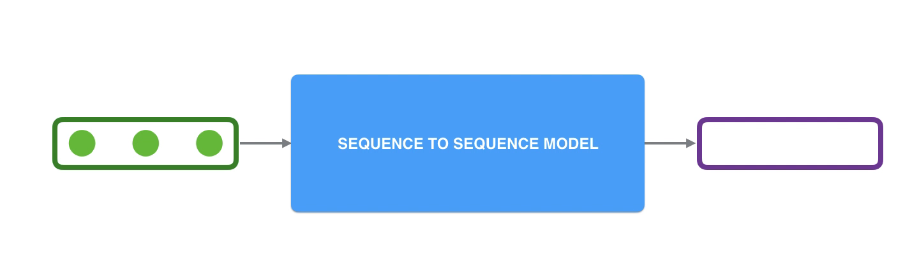
Encoder-Decoder Arch
Let's understand Encoder – Decoder Architecture

Slide 7
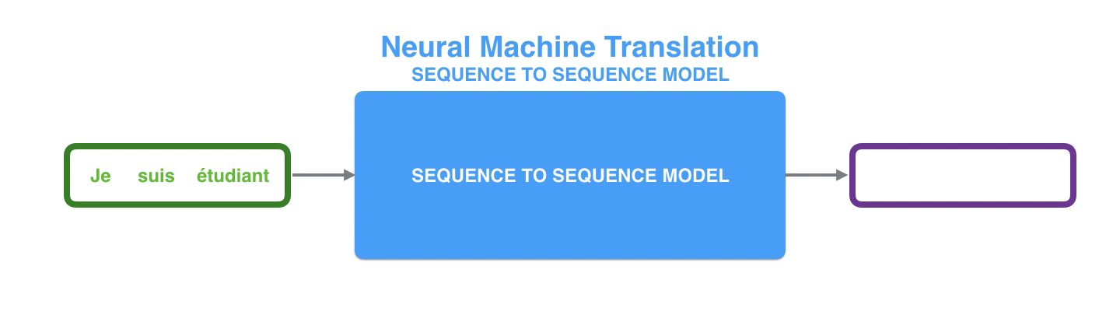
Encoder-Decoder Arch

Slide 8
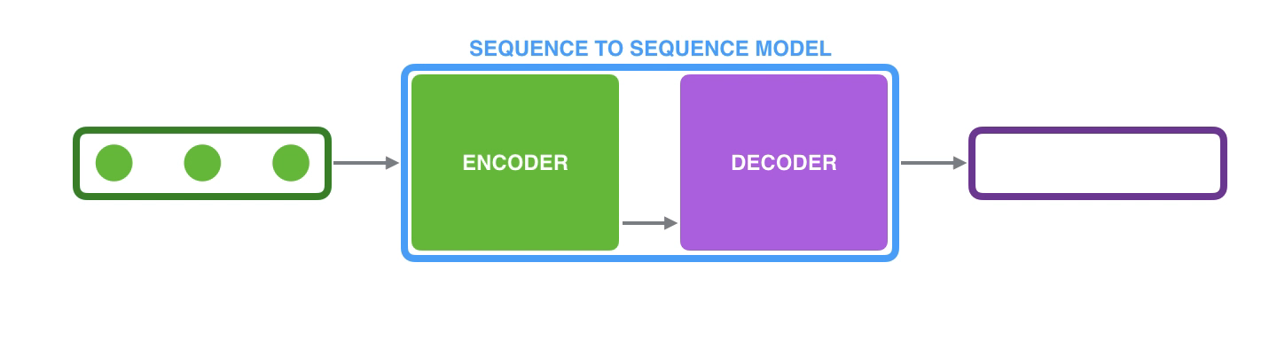
Encoder-Decoder Arch

Slide 9
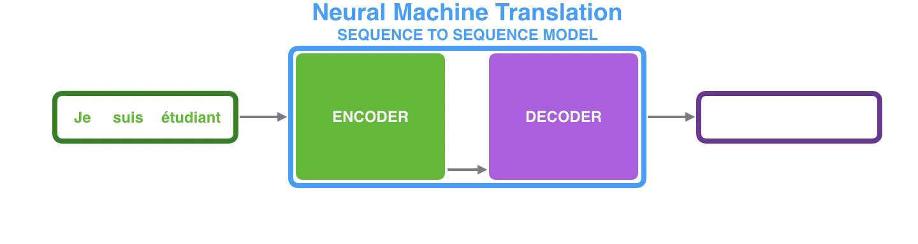
Encoder-Decoder Arch

Slide 10
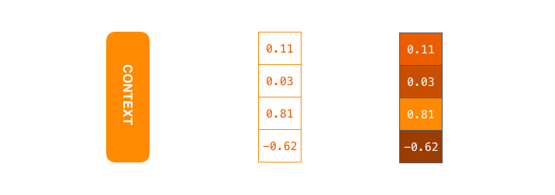
Context Vector
Vector size depends on the number of hidden units in RNN
vector would be of a size like 256, 512, or 1024.
Context Vector

Slide 11
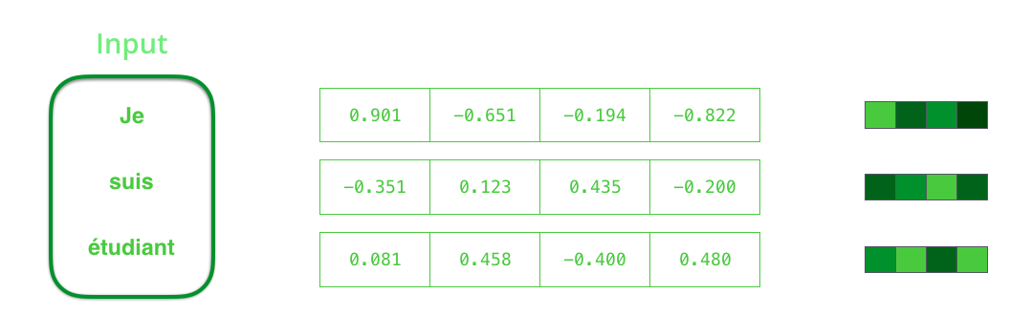
Word Embedding
To transform a word into a vector, we turn to the class of methods called “word embedding” algorithms
RNN takes two inputs at each time step: an input (in the case of the encoder, one word from the input sentence), and a hidden state

Slide 12
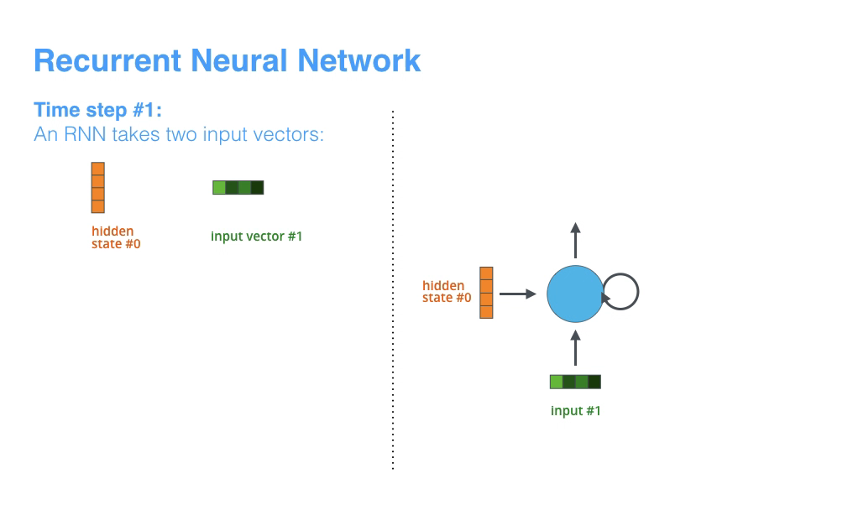
RNN
RNN takes two inputs at each time step: an input (in the case of the encoder, one word from the input sentence), and a hidden state

Slide 13
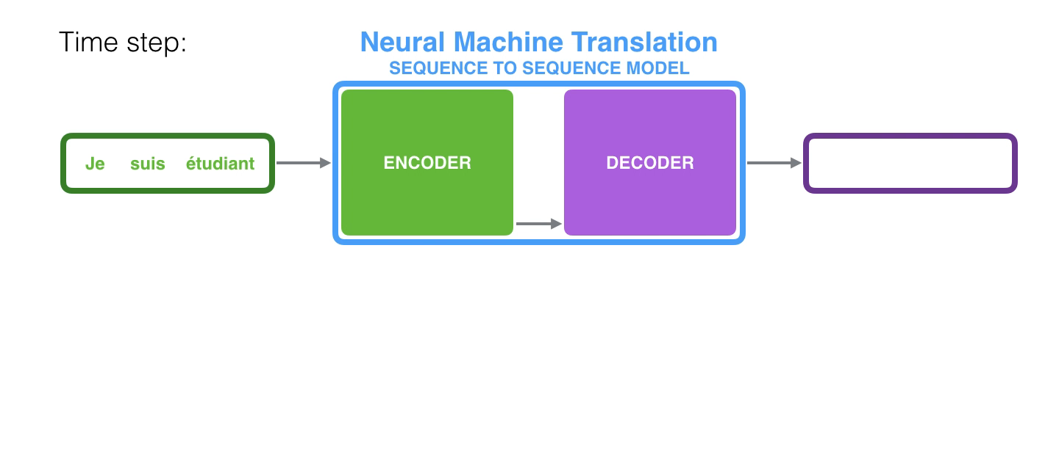
NMT

Slide 14
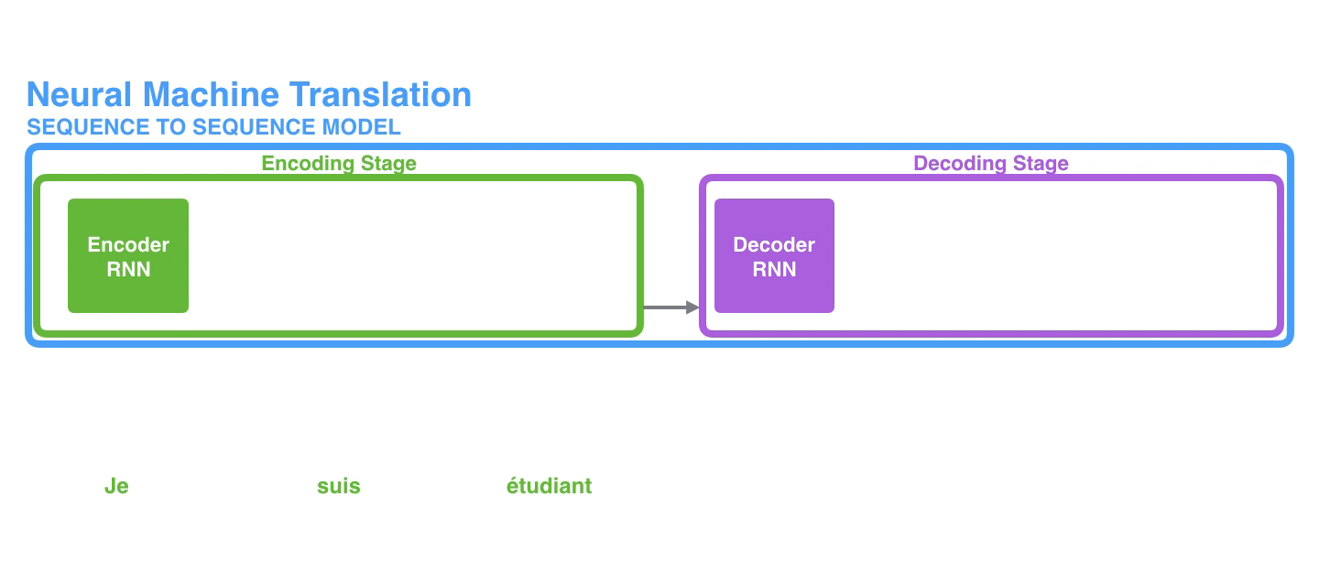
NMT Unrolled View

Slide 15
Issues without Attention
The context vector turned out to be a bottleneck for these types of models
challenging for the models to deal with long sentences
A solution was proposed in Bahdanau et al., 2014 and Luong et al., 2015 - “Attention”
Attention allows the model to focus on the relevant parts of the input sequence as needed.

Slide 16
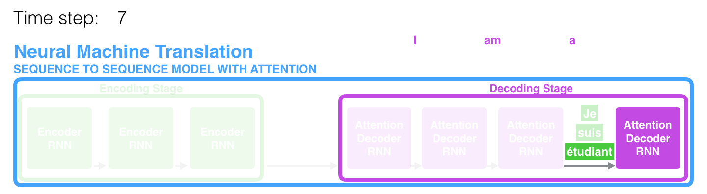
Attention
The attention mechanism enables the decoder to focus on the word "étudiant" ("student" in french) before it generates the English translation.

Slide 17
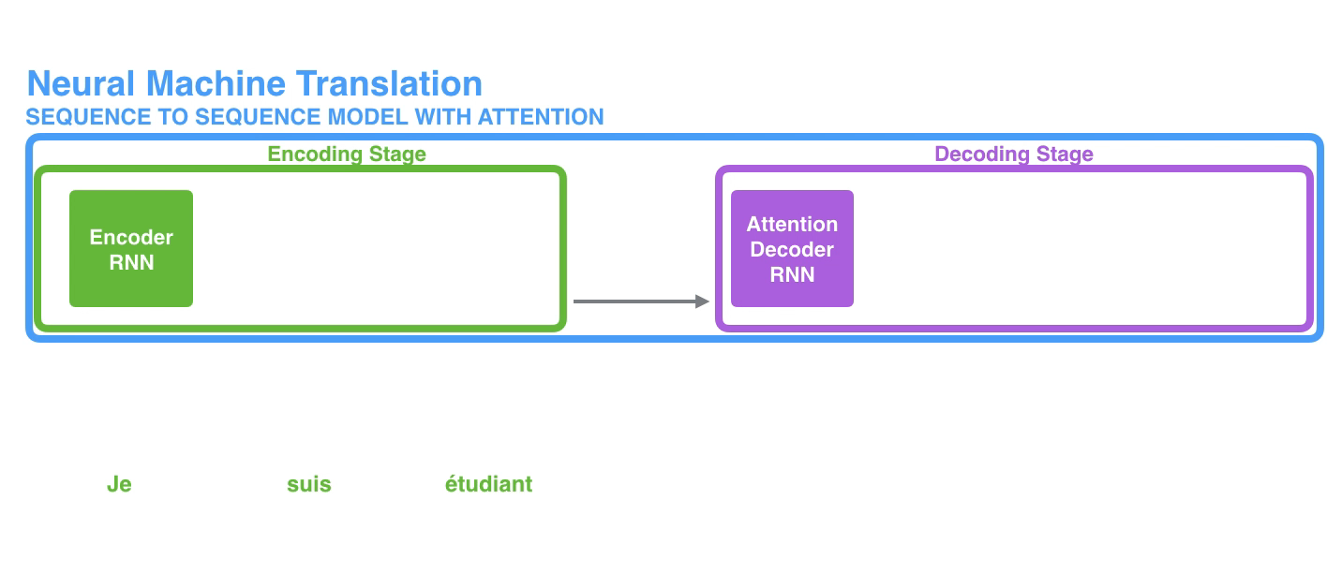
Attention: How it works
Instead of passing the last hidden state of the encoding stage, the encoder passes all the hidden states to the decoder

Slide 18
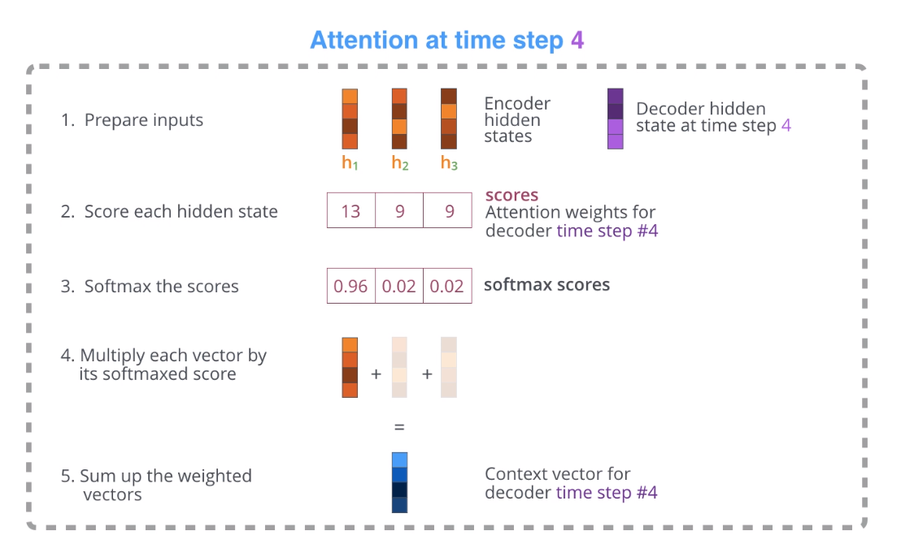
Attention: How it works
To focus on the parts of the input that are relevant to this decoding time step, the decoder does the following:
Look at the set of encoder hidden states it received – each encoder hidden state is associated with a certain word in the input sentence
Give each hidden state a score (let’s ignore how the scoring is done for now)
Multiply each hidden state by its soft-maxed score, thus amplifying hidden states with high scores, and drowning out hidden states with low scores

Slide 19
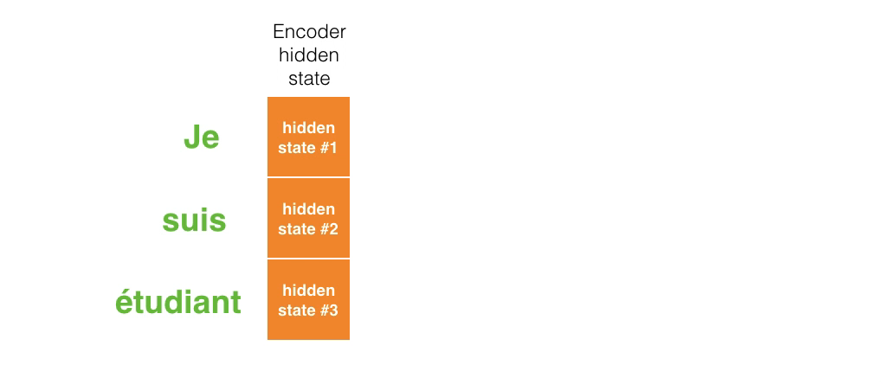
Attention: How it works

Slide 20
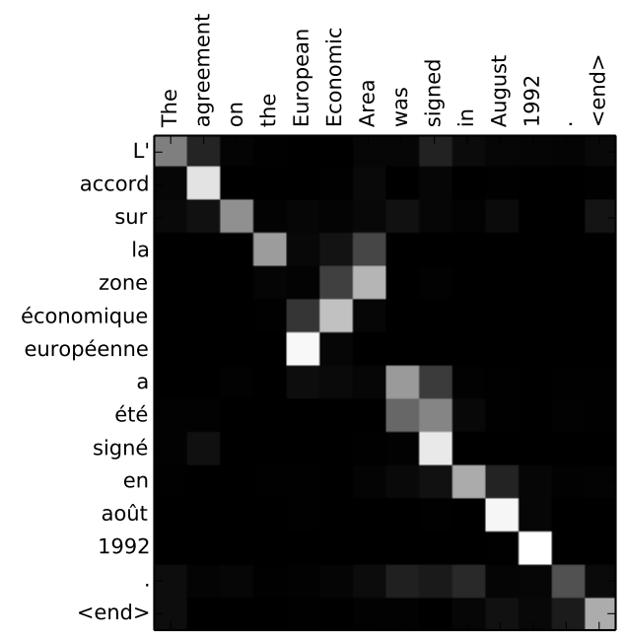
Attention: How it works

Slide 21
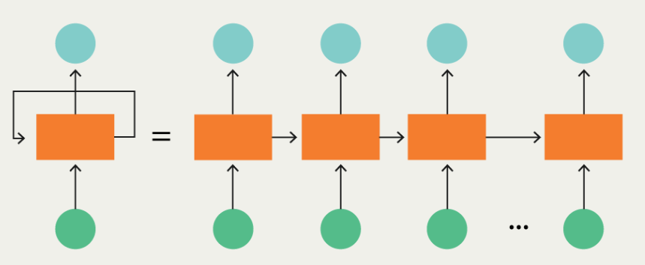
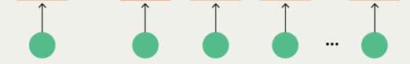
Self Attention: Why?
Seq 2 Seq : Complex
One token at a time
Each unit is a bottle neck to the flow of information
To compute the final unit output, we first have to compute all the previous unit’s output
Self Attention [Vaswani et al 2017, Attention is all you need]
Attention + CNN
Sequential
Parallel

Slide 22

What is self-attention?
Take the following sentence – “The animal didn’t cross the street because it was too tired”
What does “it” refer to? How should the transformer know this?

Slide 23
Let’s dive into self-attention

Slide 24
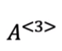
Let’s dive into self-attention

Slide 25
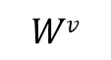
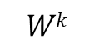
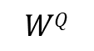
Let’s dive into self-attention
Query, Key, Value
$$WQ$$
$$Wk$$
$$Wv$$

Slide 26
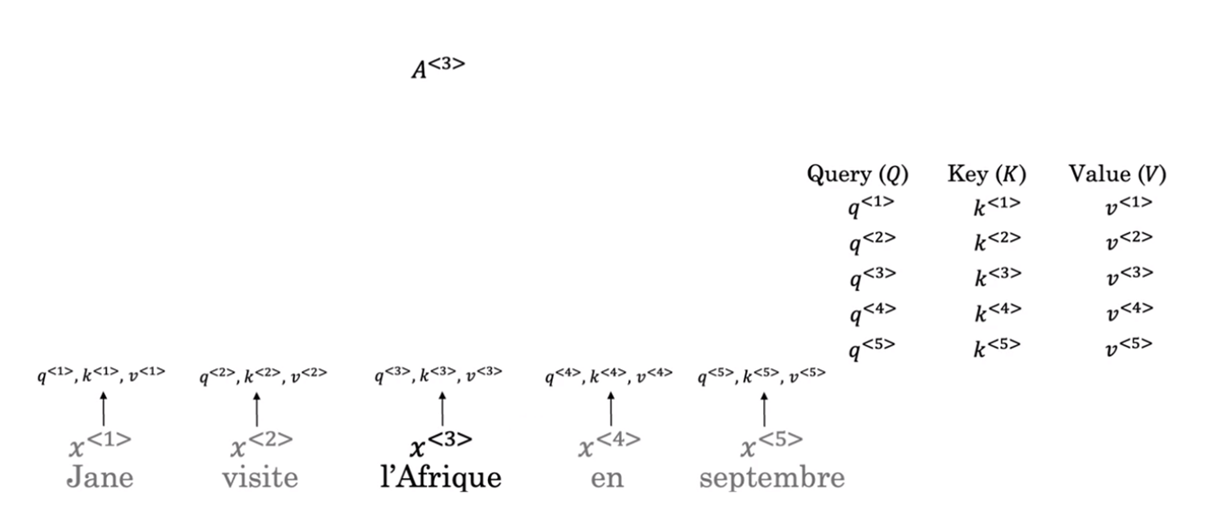
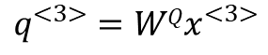
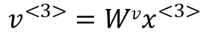
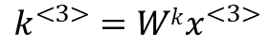
Let’s dive into self-attention
Query, Key, Value
$$q^{<3>}=WQx^{<3>}$$
$$k^{<3>}=Wkx^{<3>}$$
$$v^{<3>}=Wvx^{<3>}$$

Slide 27
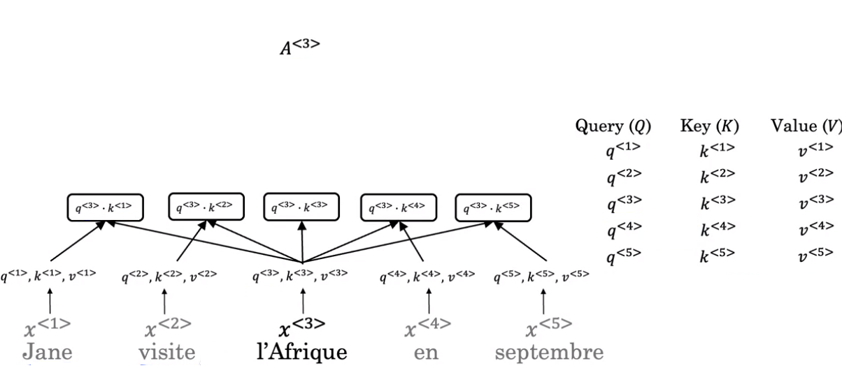
Let’s dive into self-attention
$$q^{<3>}=WQx^{<3>}$$
$$k^{<3>}=Wkx^{<3>}$$
$$v^{<3>}=Wvx^{<3>}$$

Slide 28
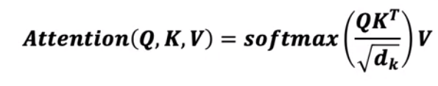
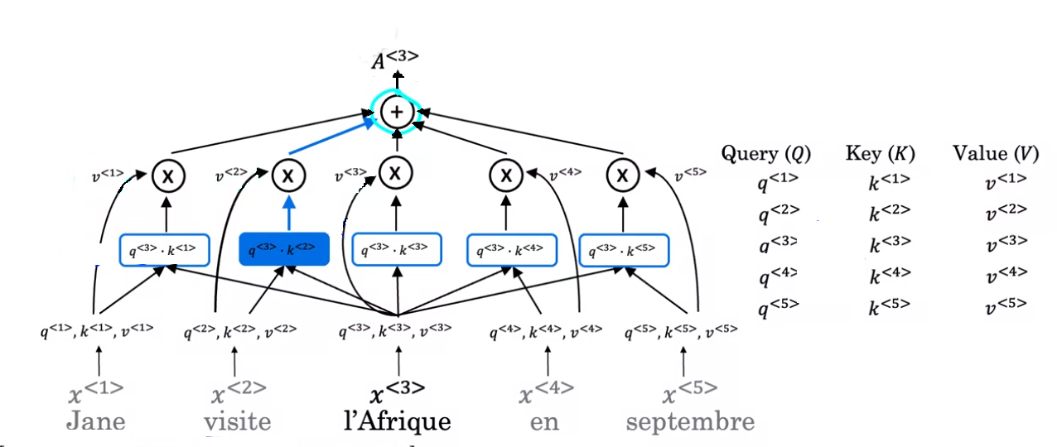
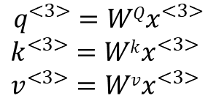
Let’s dive into self-attention

Slide 29
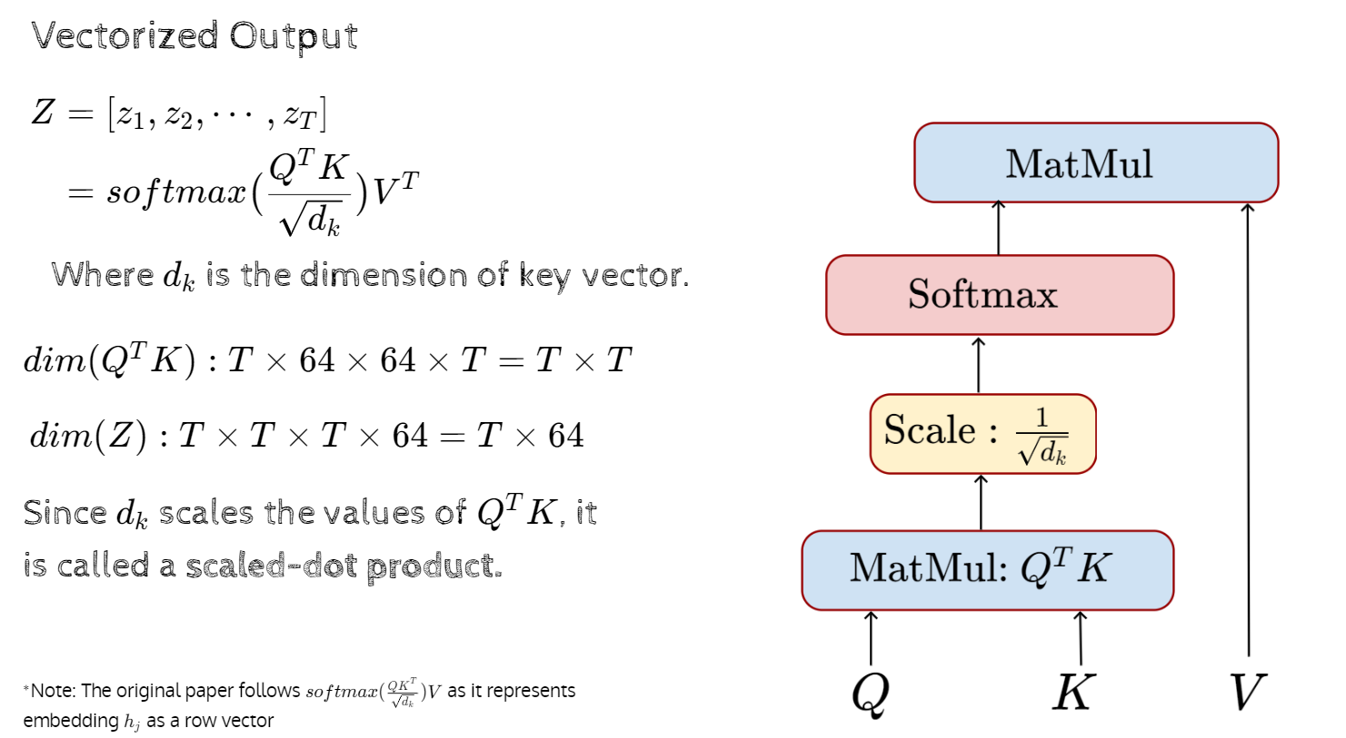
Let’s dive into self-attention

Slide 30
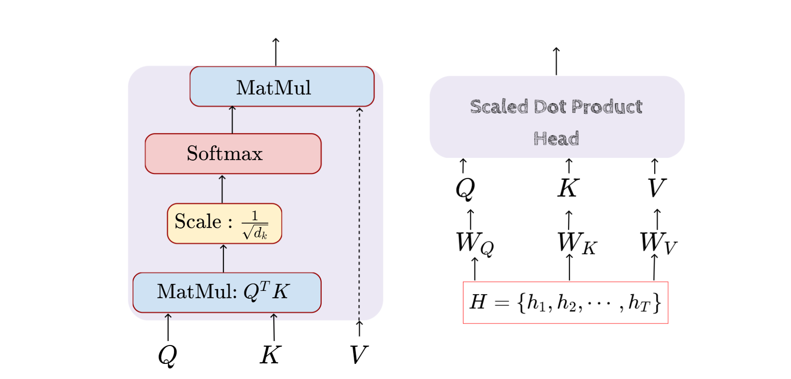
Let’s dive into self-attention

Slide 31
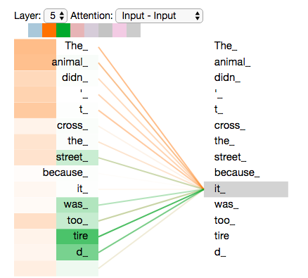
Multi-head attention - intuition
Remember the following sentence – “The animal didn’t cross the street because it was too tired”
Why should a certain word focus on only one part of the sentence?
Several “attentions” allow each word to focus on several areas in the sentence simultaneously

Slide 32
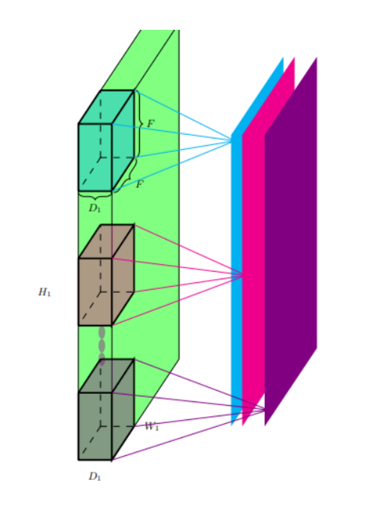
Multi-head attention - intuition
What is the significance of having more than one filter/kernel in a CNN layer
To learn more abstract representations, capture more meaningful interactions between inputs
Similarly, we can have more than one self-attention heads with different parameter matrices with a hope that it learns subtle contextual information.

Slide 33
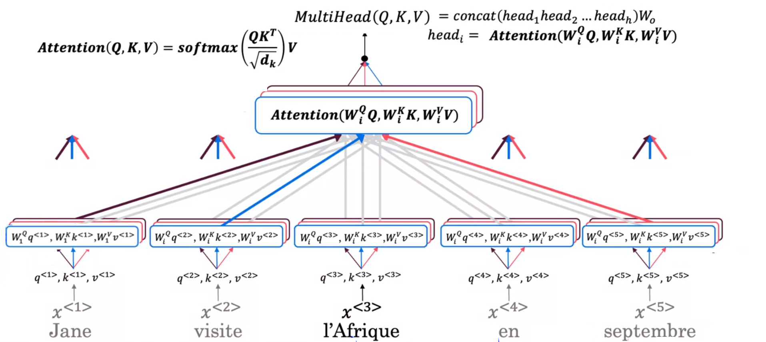
Multi-head attention

Slide 34
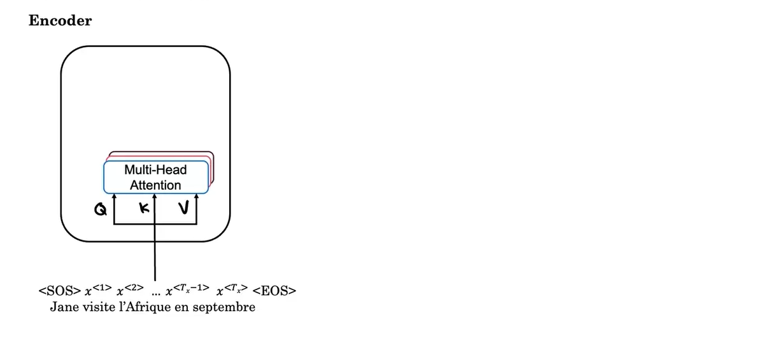
Transformers

Slide 35
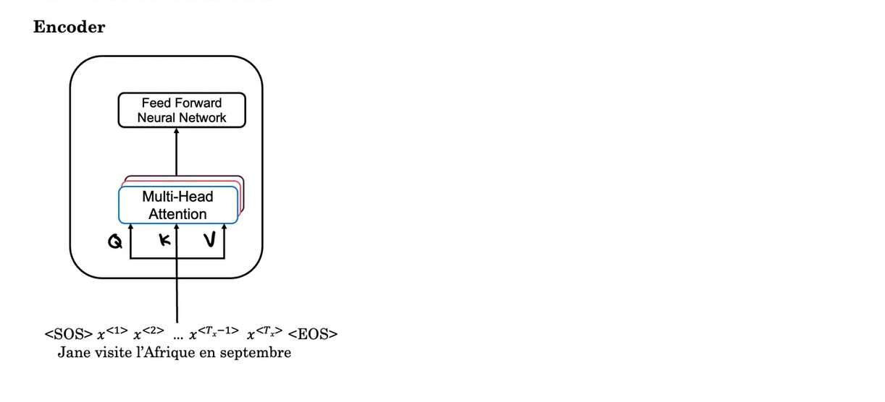
Transformers
N Times

Slide 36
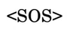
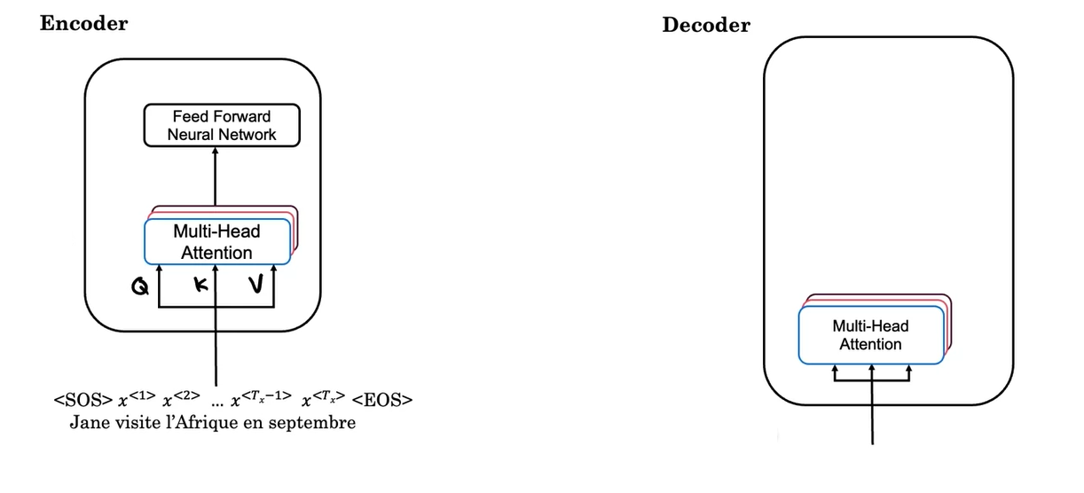
Transformers
N Times

Slide 37
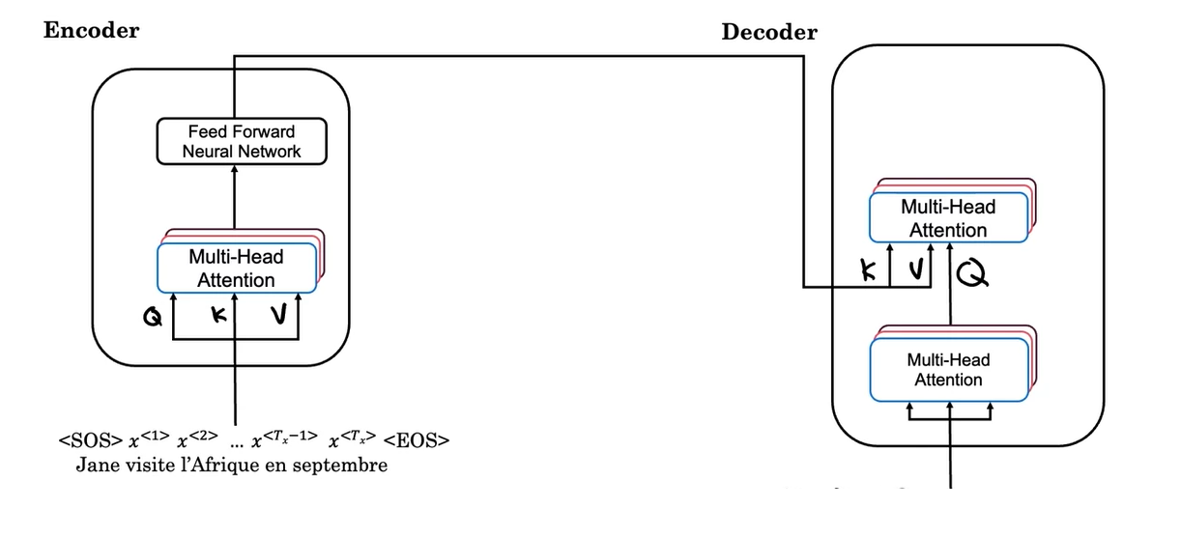
Transformers
N Times

Slide 38
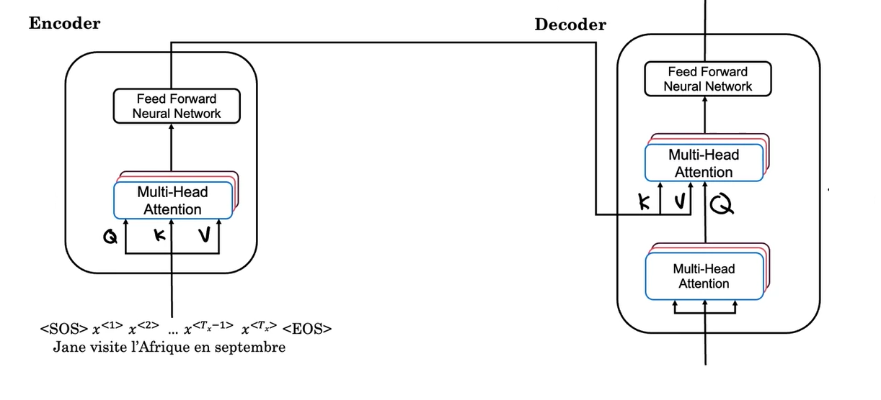
Transformers
N Times

Slide 39
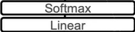
Transformers
N Times

Slide 40
Transformers
N Times

Slide 41
Transformers
N Times

Slide 42
Transformers
N Times

Slide 43
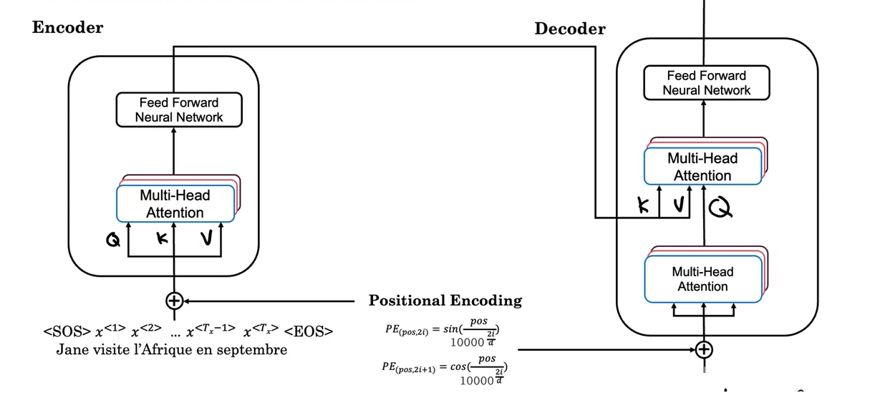
Transformers
N Times

Slide 44
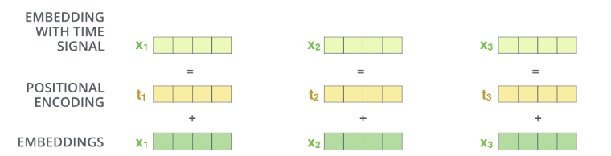
Transformers
N Times

Slide 45
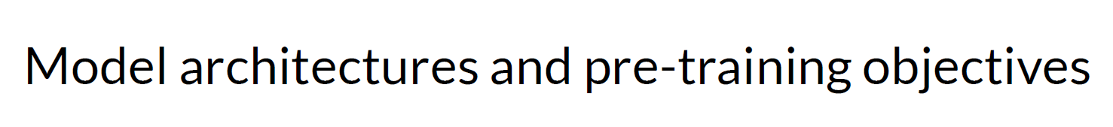

Slide 46
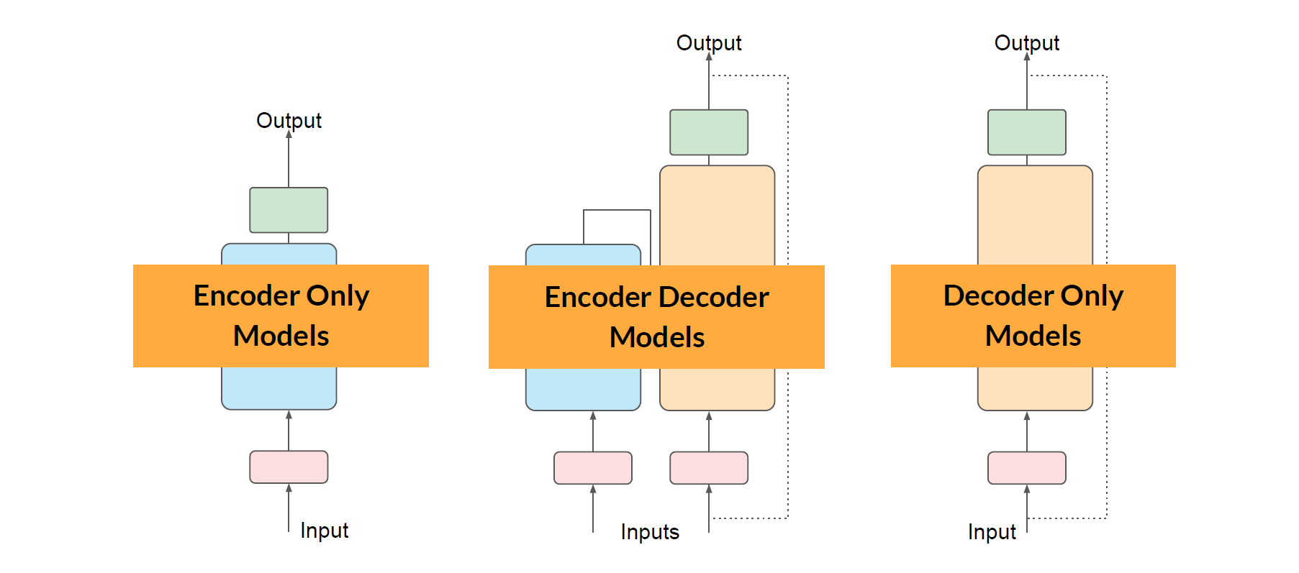
Transformers: Architecture

Slide 47
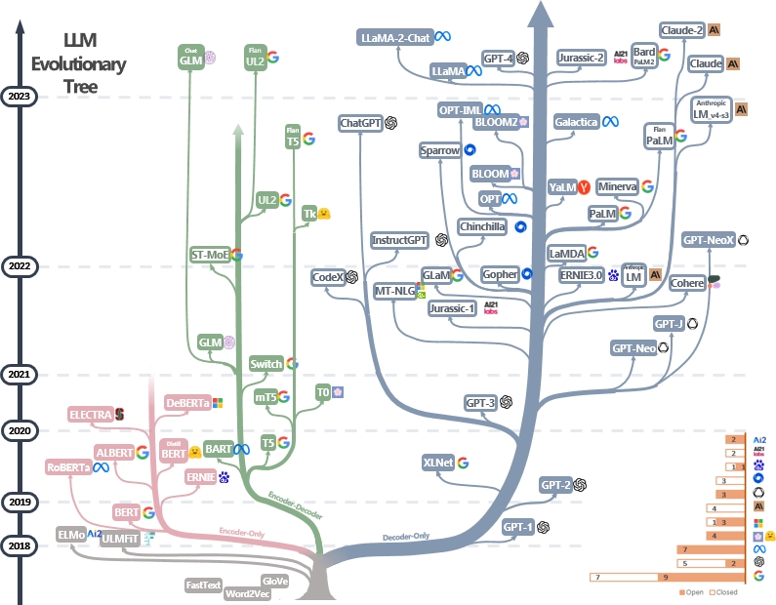
Transformers: Architecture

Slide 48
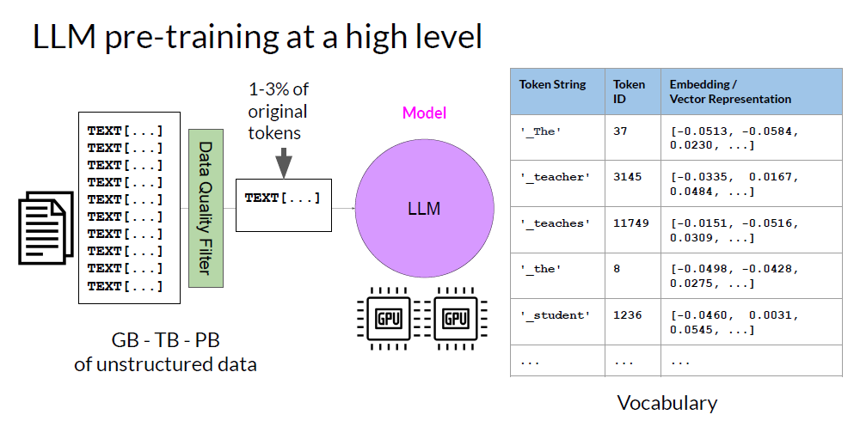

Slide 49
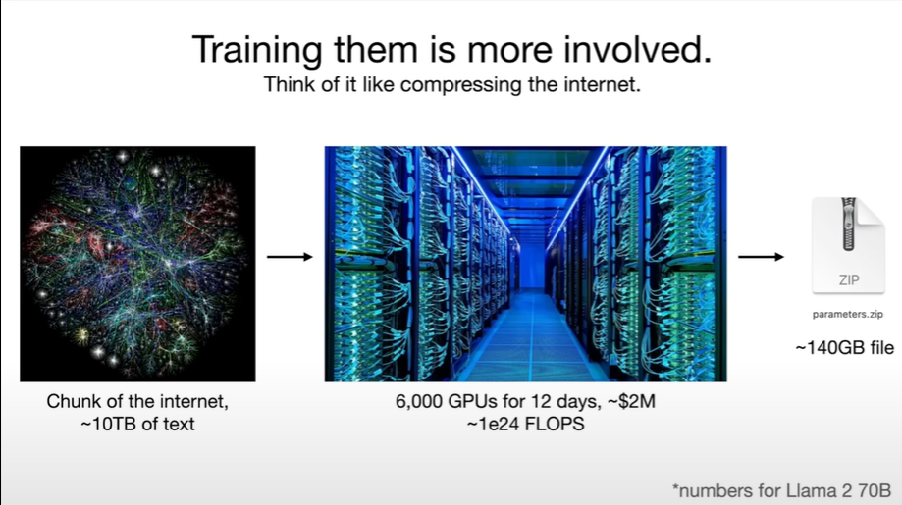
Intro to Large Language Models- Anderj Karpathy

Slide 50
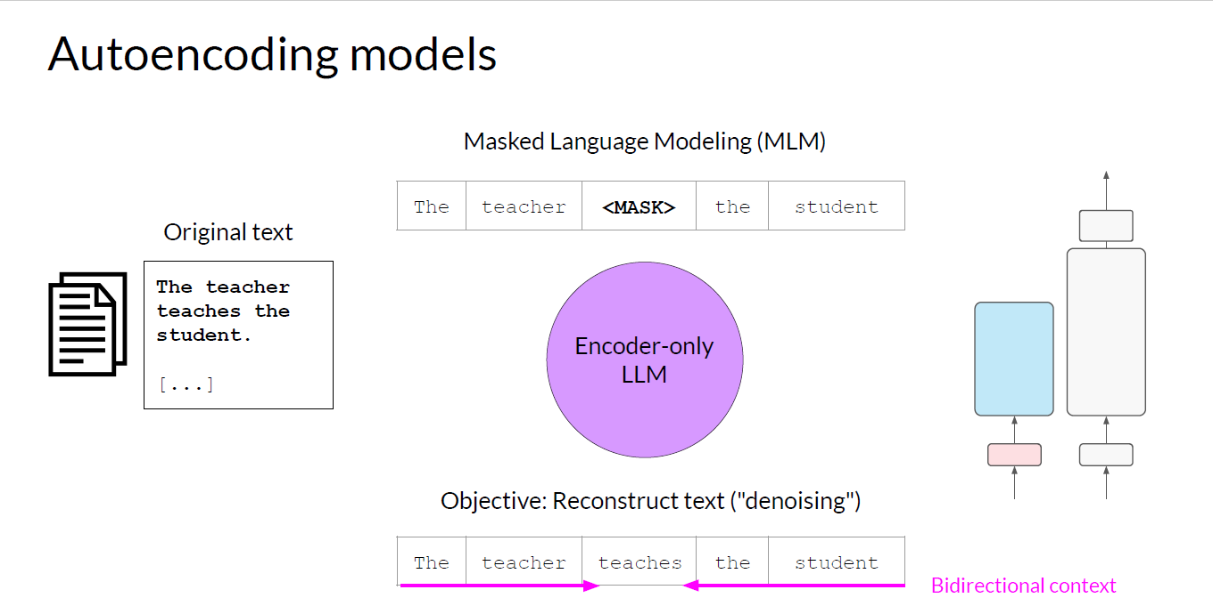
Transformers: Architecture

Slide 51
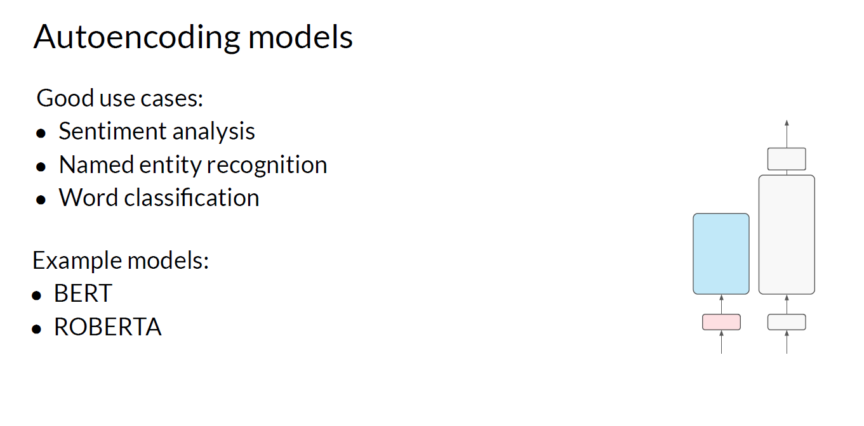
Transformers: Architecture

Slide 52

Transformers: Architecture

Slide 53

Transformers: Architecture

Slide 54

Transformers: Architecture

Slide 55

Transformers: Architecture

Slide 56

Transformers: Architecture

